Slide 1
FIORI STANDARD APP ACTIVATION & EXSTENSION

Slide 2
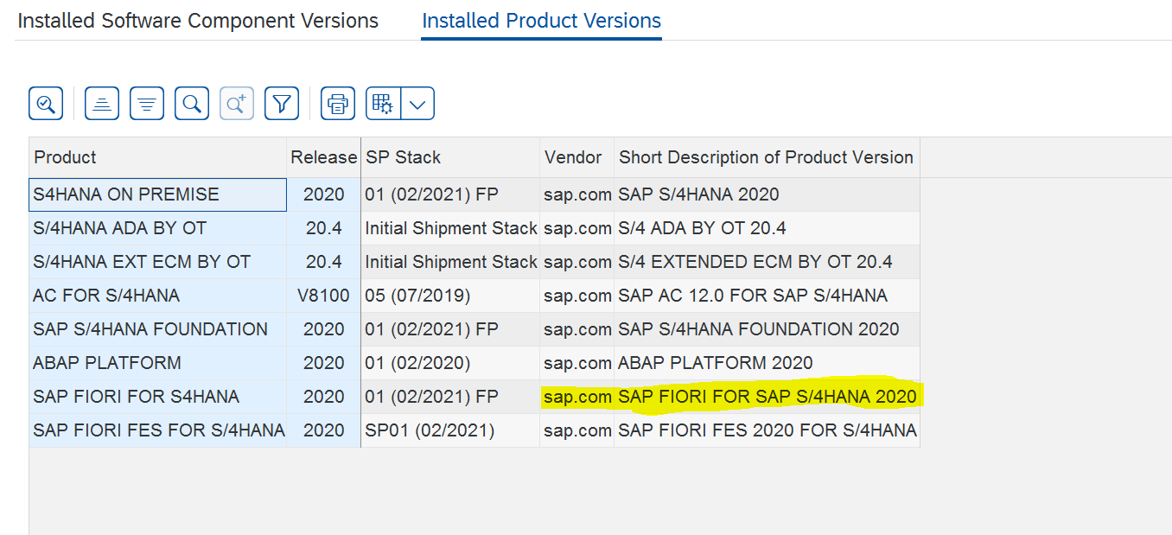
→ As part of Standard App Activation, We have to check some configurations.
Which Fiori Version, our current system is?? Follow below screenshots to find Fiori System Version.
Go to System -> Status -> SAP System Data -> Installed Product Version.
Please find below screen for your reference.

Slide 3
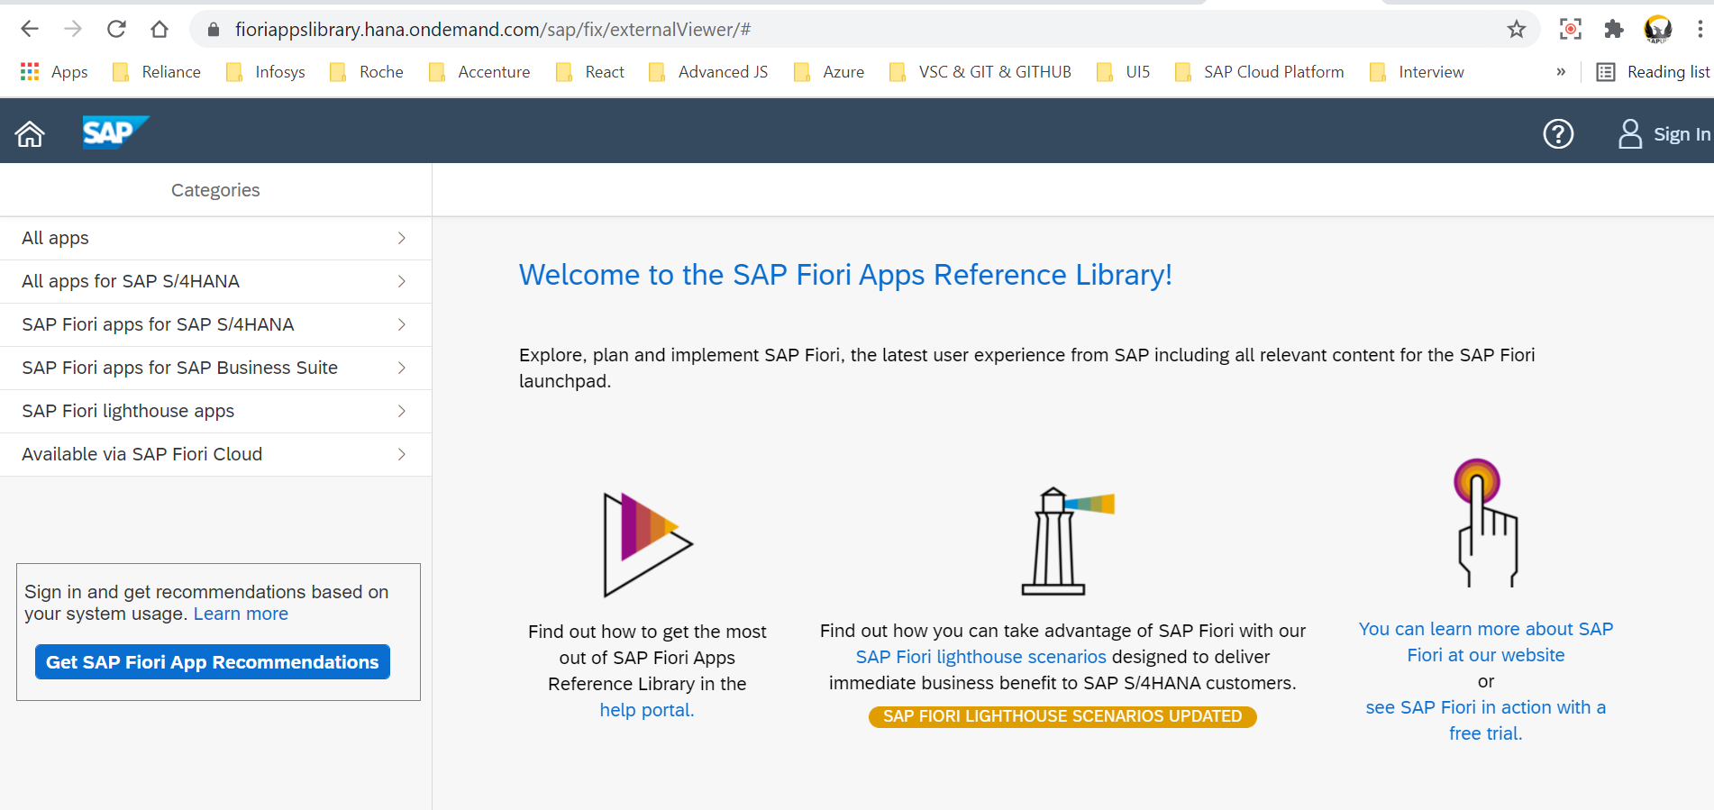
→ Once we get to know about fiori version, need to take requirements from functionals, Here Have to get Fiori App ID’s from Functionals based on Requirements.
Once we get that App ID, we have a fiori library where we can get to know about App Details such as BSP, Odata Service, Catalog, Group, Target Mapping etc.
Fiori Reference Library URL : https://fioriappslibrary.hana.ondemand.com/

Slide 4
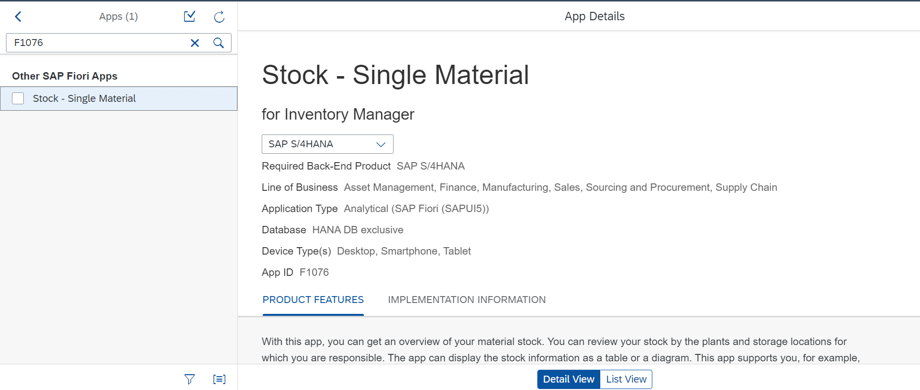
Go to All Apps and search with APP ID : F1076

Slide 5
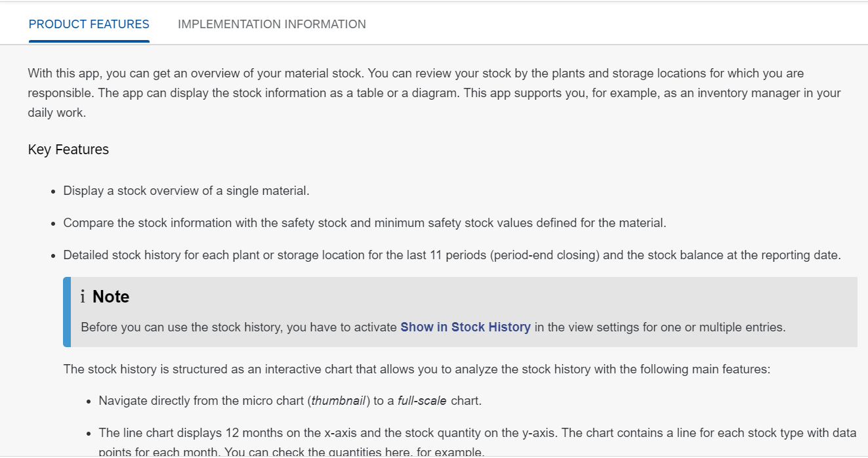
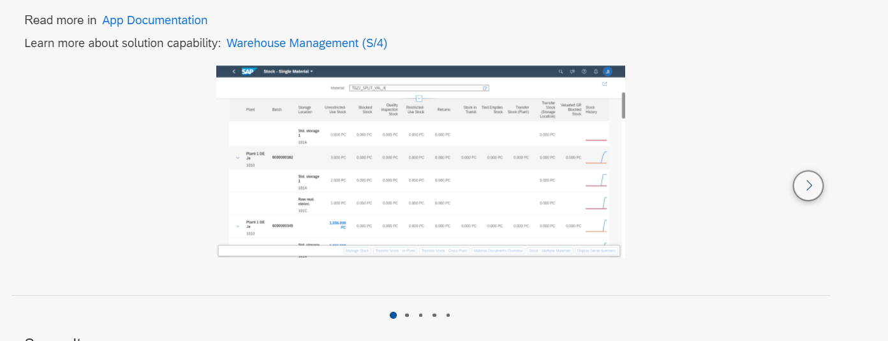

Slide 6
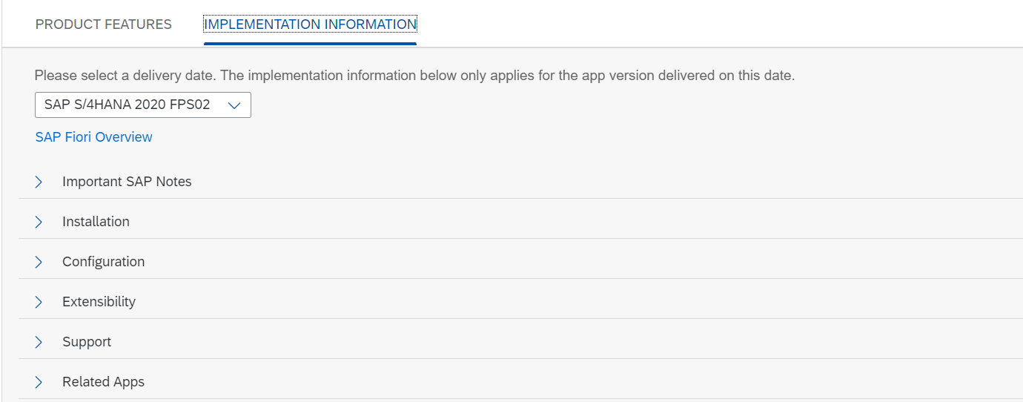
Important one is IMPLEMENTATION INFORMATION TAB, From here we can get all the configuration and technical details of Fiori App.
→ We have to Select our Fiori version from below dropdown and we can all sections Installation, Configuration, Extensibility, Support. We will see one by one.

Slide 7
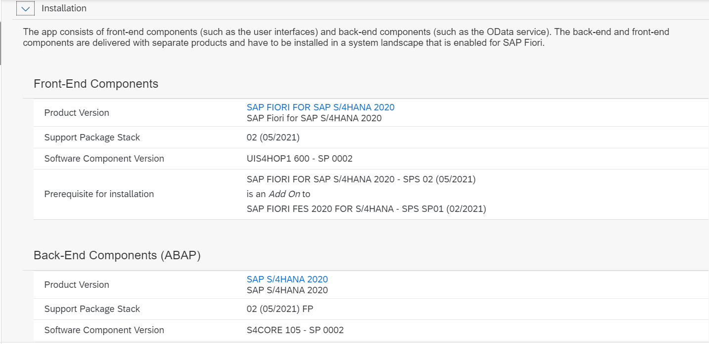
We have to make sure weather below components installed or not in our landscape.

Slide 8
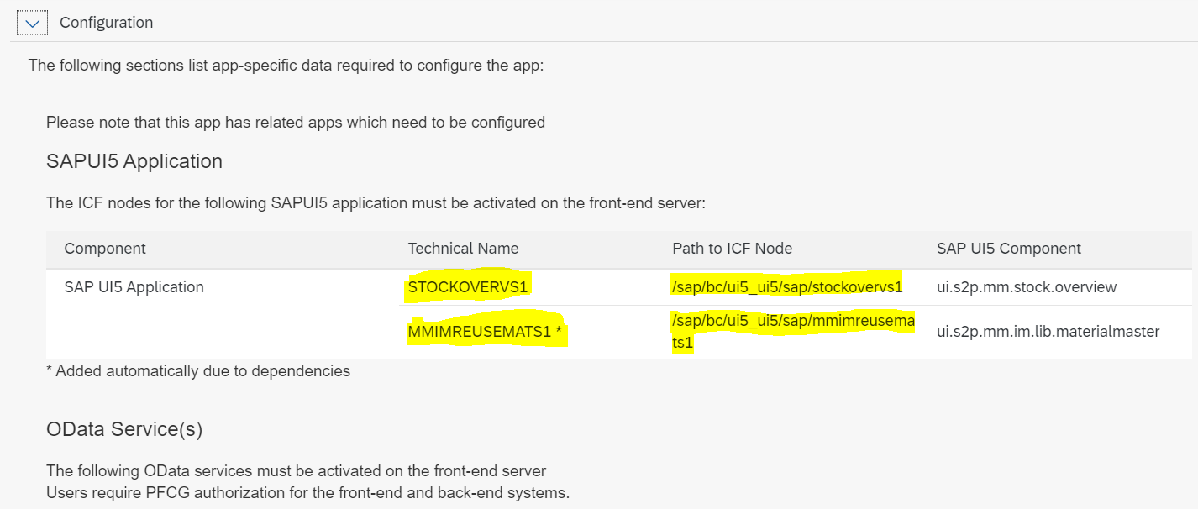
Most Important Section Configuration Tab, These two Paths we have activate in SICF T-Code.

Slide 9
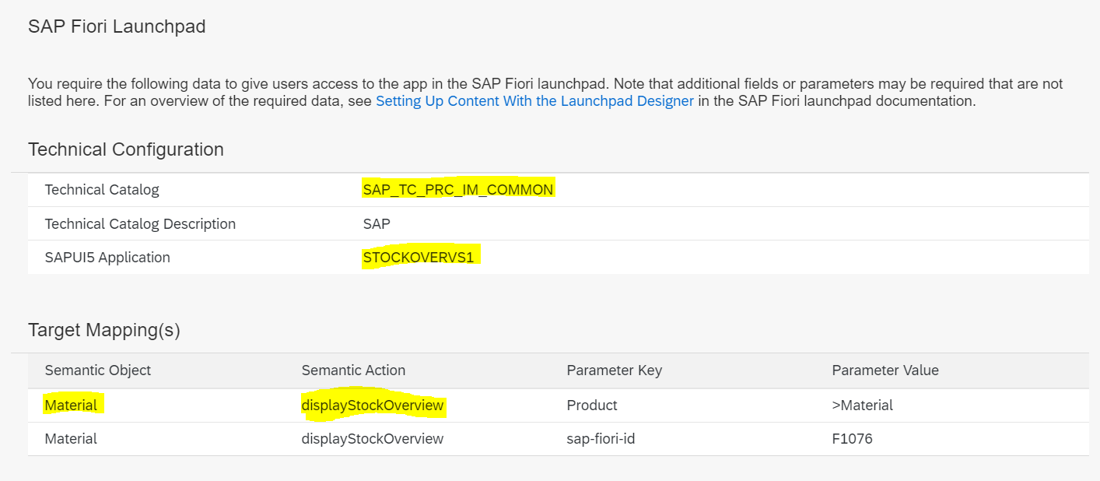
Below Details required for Fiori Launchpad Configuration.

Slide 10
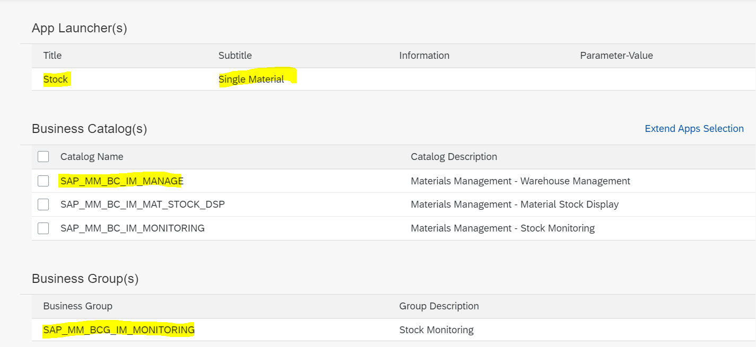
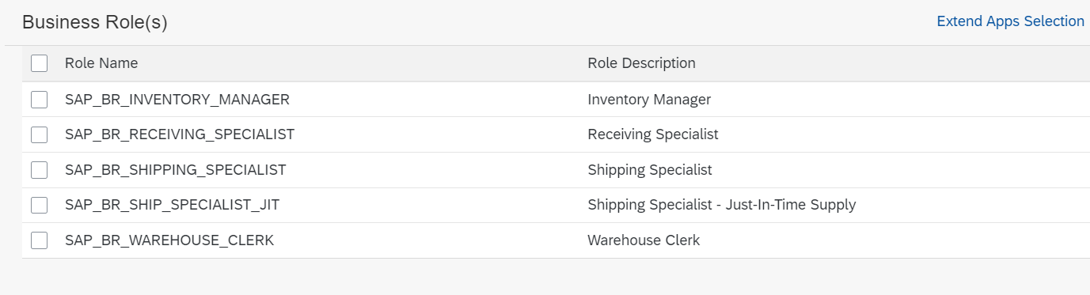

Slide 11
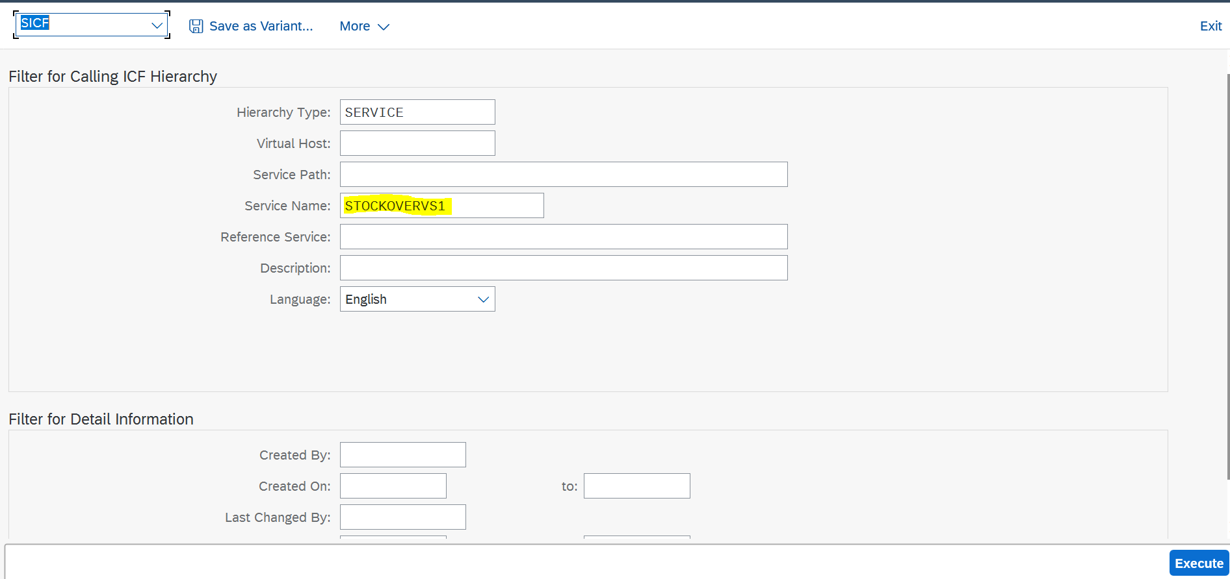
After Getting all the required details from Library, Have to go to SAP GUI and Activate SICF Paths for UI5 and Odata.
BSP Name Activate:

Slide 12
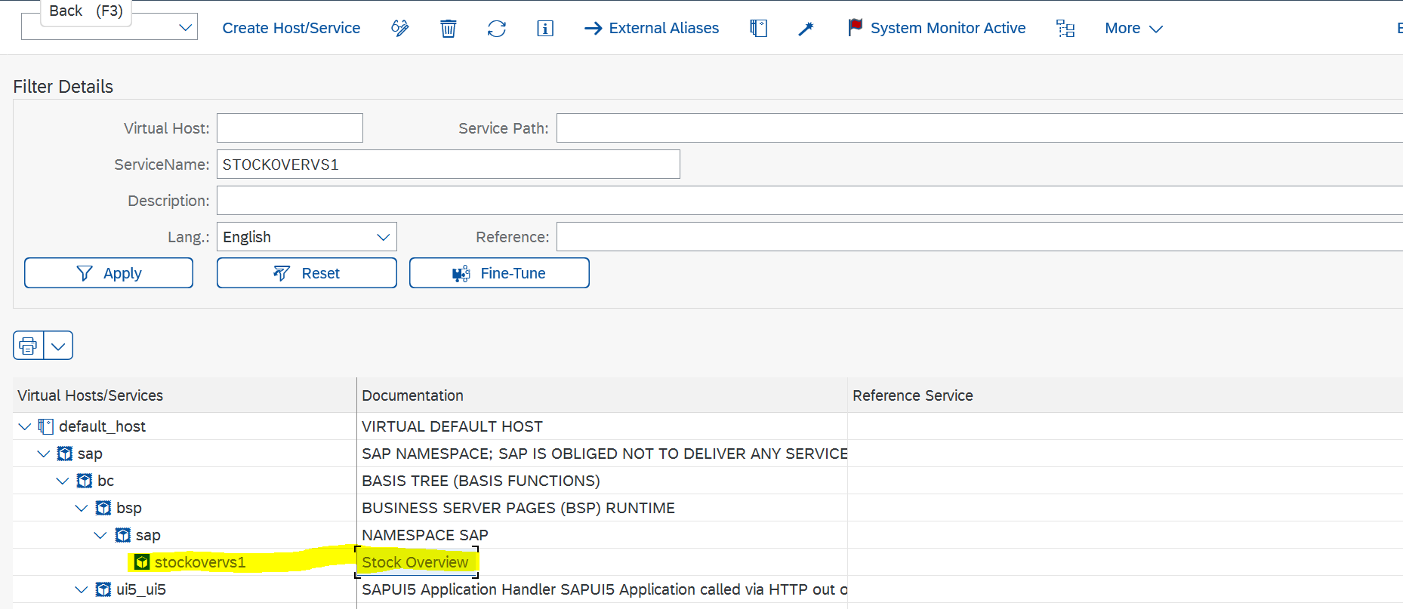

Slide 13
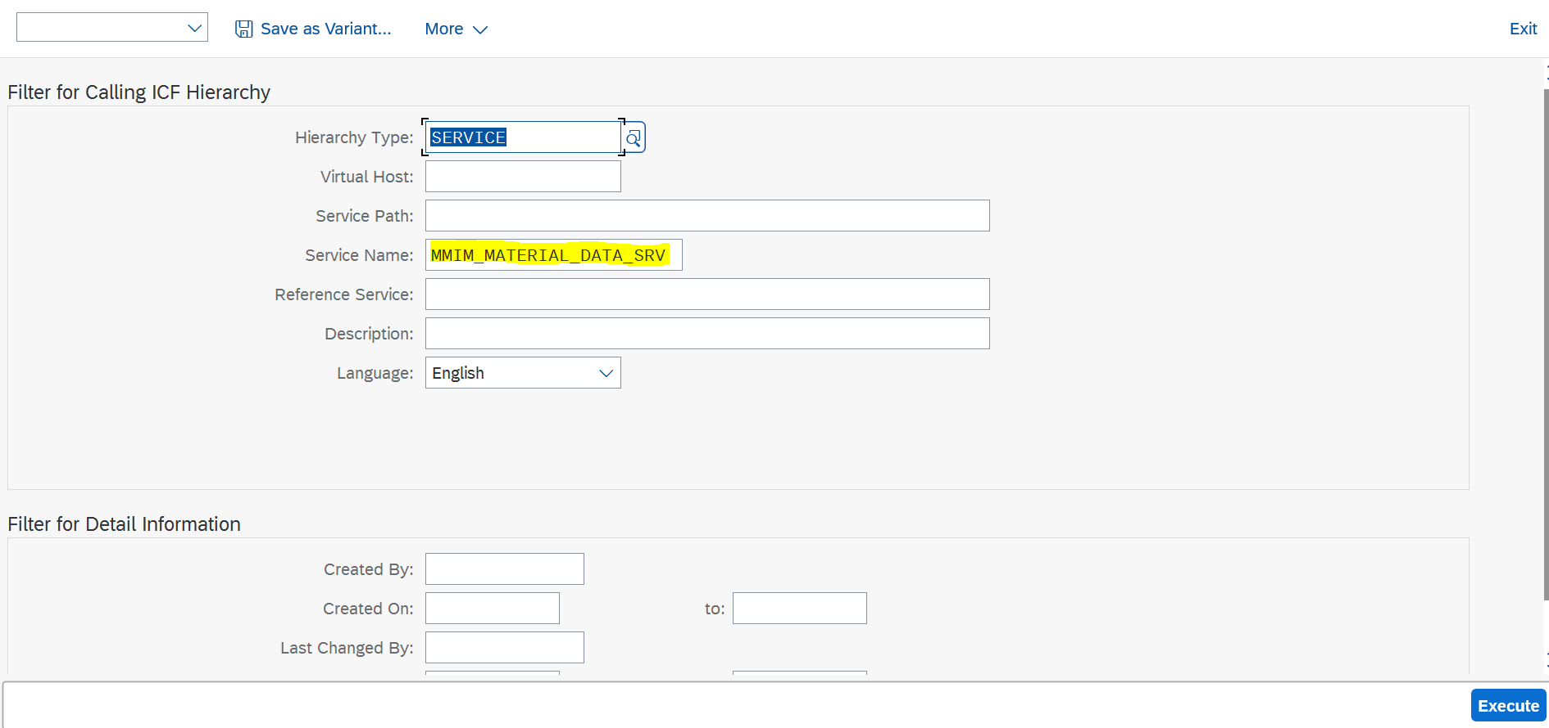
Odata SICF Activate:
--------------------------

Slide 14
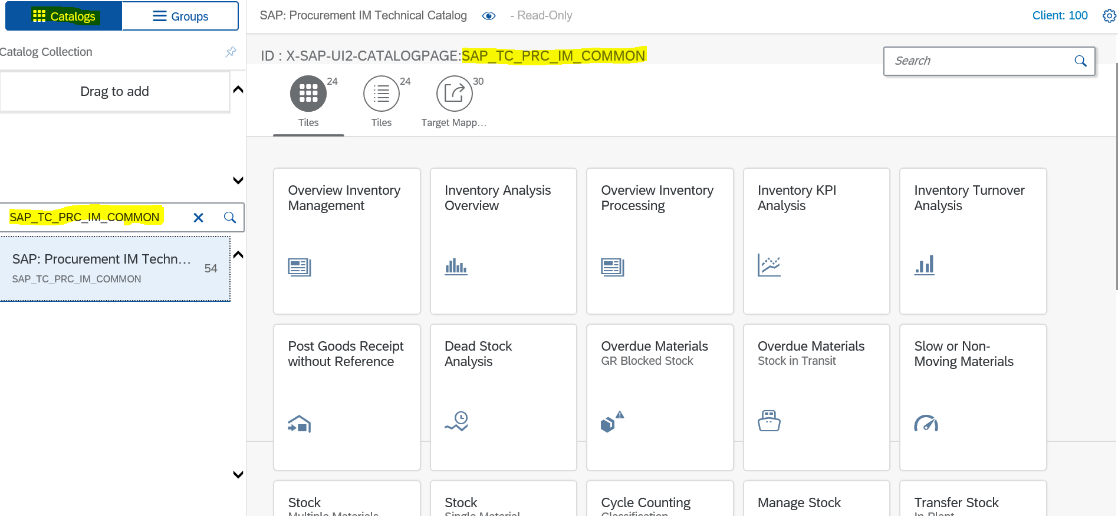
After Activating SICF Nodes, We should go to Launchpad Designer Tool. /n/ui2/flpd_cust. There we need to create Reference of Tile and Target Mapping from Standard Catalog to Custom Catalog. We can get Standard Catalog from Library.

Slide 15
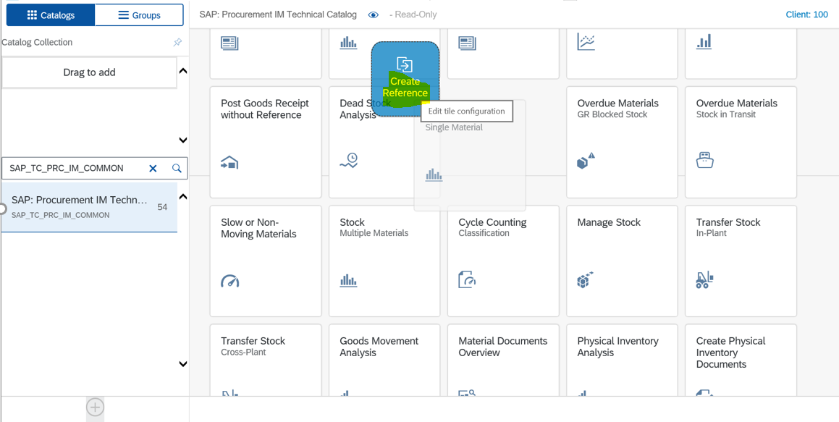

Slide 16
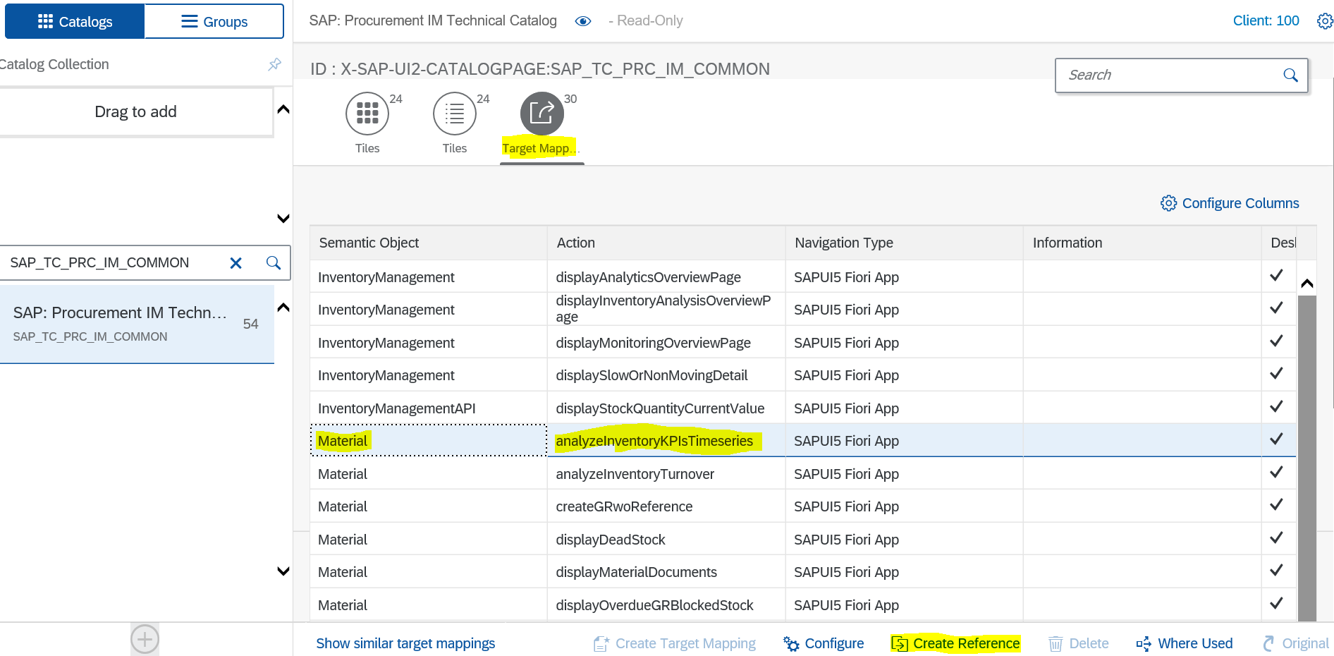
Create reference Target Mapping also

Slide 17
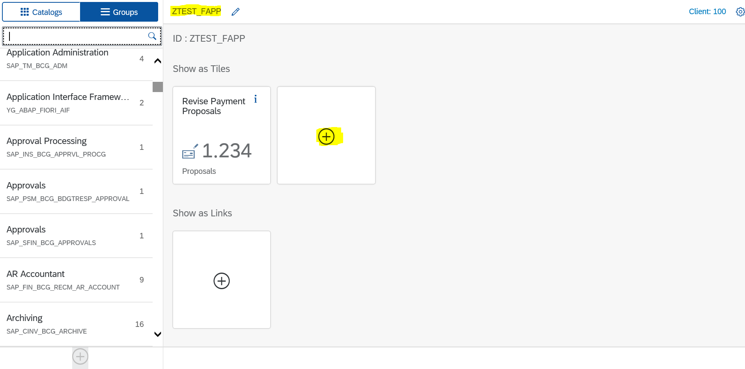
Once done with the creating References for Both Tile and Target Mapping. We Have to Assign That Catalog to Custom Group.

Slide 18
→Once done with the Catalog and Group, Have to go to PFCG T-Code.
→There Have to Create Custom Role and Assign our Catalog and Group to created Role.
→Once Done with the Catalog and Group Assignments to Role, Next step will be that Role needs to be Assign to User ID.
→We can Assign User ID to Role In SU01 T-Code.
→Finally, Logon into fiori launchpad, we should be able to see the app in created group.
→For Activating Fiori Standard Application, We should have workbench and Customizing TR.

Slide 19
.
STANDARD FIORI APP EXTENSION
Sometimes, Client will not satisfied with standard functionality which SAP has given, In this case we need to add custom functionality to fiori standard application.
For Custom functionality, SAP has given custom points, their only we should should customization. These custom points we can get from fiori app library.
For customization, we should know about ui5 framework.
In Slide, I have given how many ways we can extend fiori standard Application. Please check it once.

Slide 20
Replace Service : we should not forget to add multi origin[mo] to Extended odata service
View Modification : With this Technique, we can do only Hide/Unhide a UI Elements only.
View Extension : In the view, there is some extension points. the extension points is a place, where we can inject our code or logic.
Controller Extension
View Replacement
Controller Replacement
I18n extension
if you want to use any one of these among the 7 Techniques, Follow below steps.
Select Project –> Go To Tools --> Select Extendibility Panel --> In the Extendibility panel, left-hand side it shows output and right-hand side, it shows view and controller hierarchy. → Go to Preview Mode Dropdown and select Extendibility Mode. → If you want to hide button, Right click on it and

